Slide 1

Daffodil International University (DIU)
Department of Software Engineering (SWE)
MSc in Cyber Security (CS)
CS 506
Computer Architecture

Slide 2
Lecture 03
Modern Processor Design:
Dynamic Scheduling, Multithreading, CMPs, and GPUs
Four main concepts:
Dynamic Instruction Scheduling
Multithreading
Chip Multiprocessors (CMPs)
Graphics Processing Units (GPUs)

Slide 3
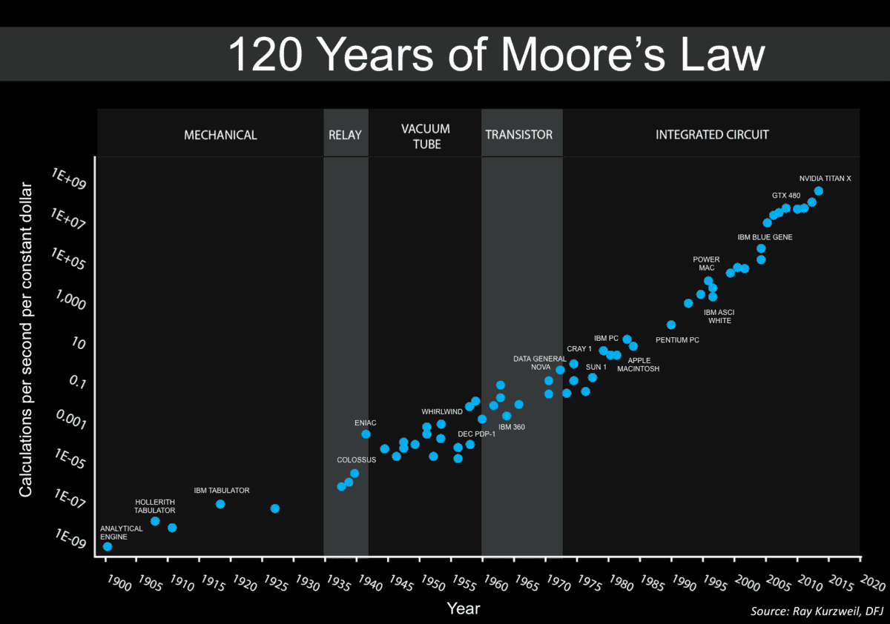
Why Modern CPUs Need Smarter Execution Models
Moore’s Law slowing down:
Physical Limits of Transistor Size(below 5 nm, Quantum tunneling, eakage current).
Complexity in Design and Validation
Slowing Innovation in Materials
Need for higher performance without faster clocks
CPU design is shifting toward:
Parallelism (more cores and threads)
Pipelining (breaking execution into stages)
Heterogeneous computing (combining CPUs + GPUs + NPUs)
Specialized hardware (GPUs, AI chips)

Slide 4
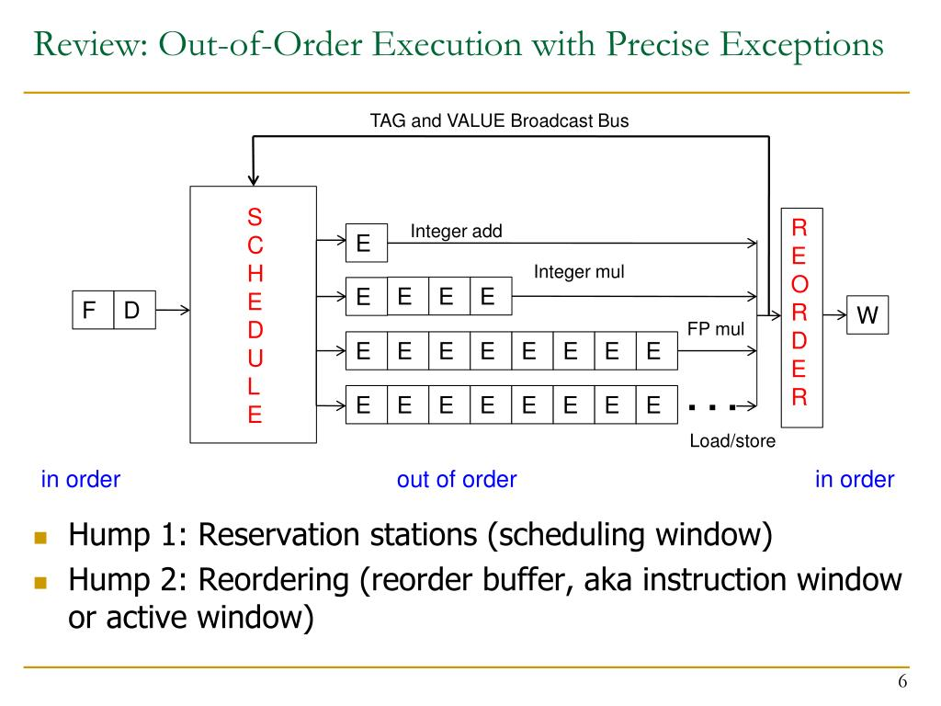
What is Dynamic Scheduling?
Dynamic Instruction Scheduling: Out-of-Order Execution
Avoids stalls by reordering instructions
Executes instructions as soon as operands are available
Fully handled by hardware (not the compiler)
Uses:
Instruction Window (holds upcoming instructions)
Reservation Stations (wait for operands)
Reorder Buffer (ROB) (commit in-order)

Slide 5
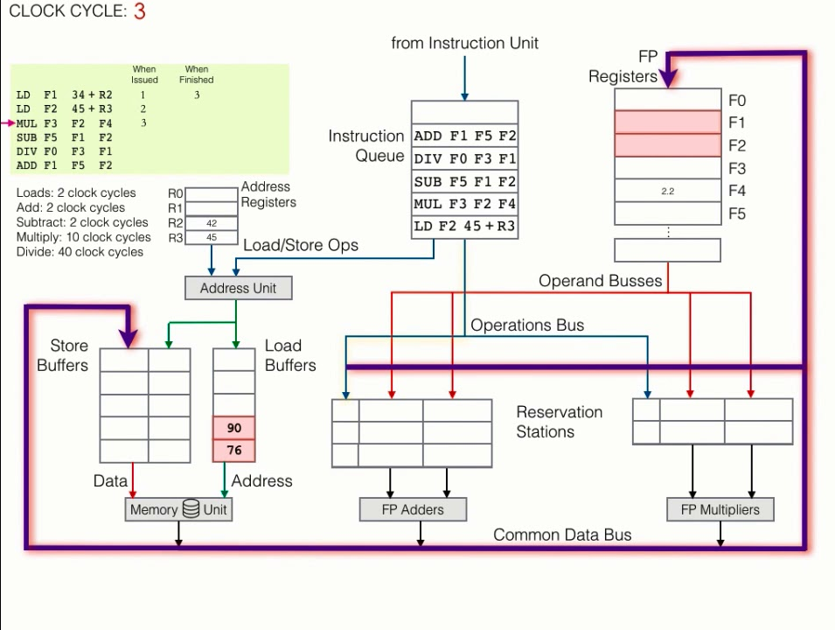
Tomasulo’s Algorithm
A dynamic scheduling method
Handles data hazards: RAW, WAR, WAW
Introduced register renaming
Instructions sit in reservation stations until operands are ready
Results broadcast on a Common Data Bus (CDB)

Slide 6
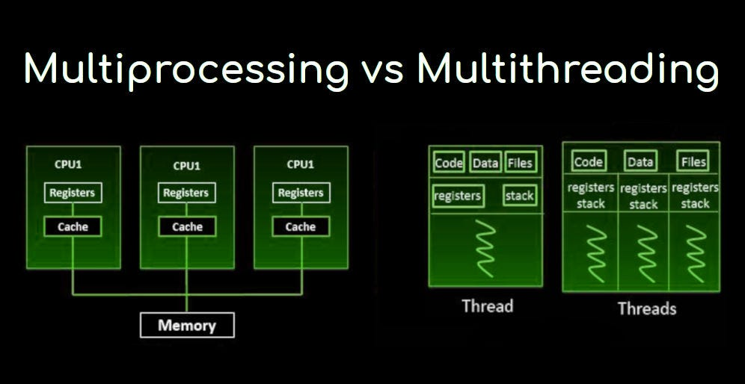
Introduction to Multithreading
CPUs can switch between threads to hide latency
Keeps core busy while one thread is waiting
Types:
Fine-Grained: switch threads every cycle
Coarse-Grained: switch on long stalls
Simultaneous (SMT): multiple threads issue in same cycle

Slide 7
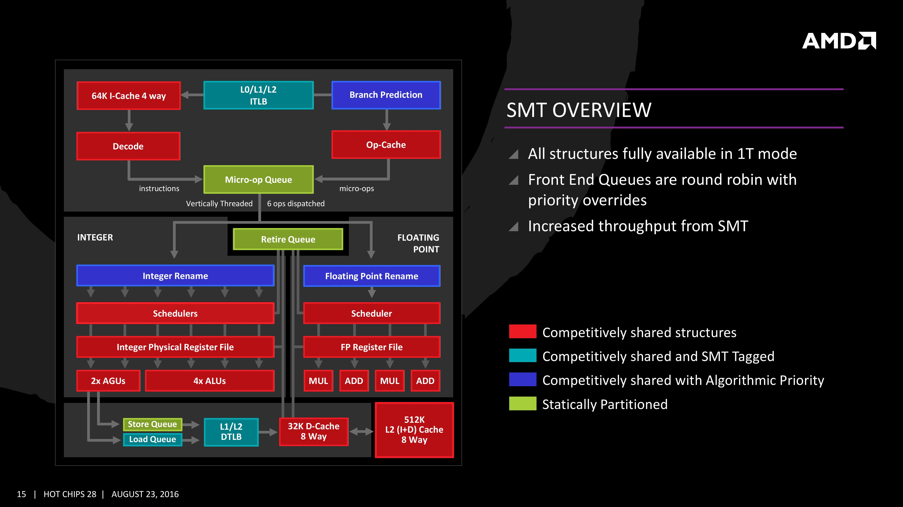
Simultaneous Multithreading (SMT)
SMT lets multiple threads share one pipeline
Used in Intel’s Hyper-Threading
Threads share ALUs, registers, and caches
Boosts throughput, not always single-thread speed

Slide 8
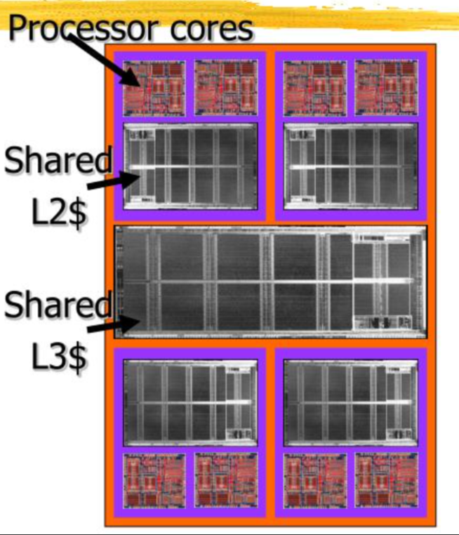
Chip Multiprocessors (CMPs)
Integrates multiple cores on a single chip
Each core can run its own thread(s) independently
Cores may share L2/L3 caches
Increases performance for parallel applications
Requires support from OS and software

Slide 9
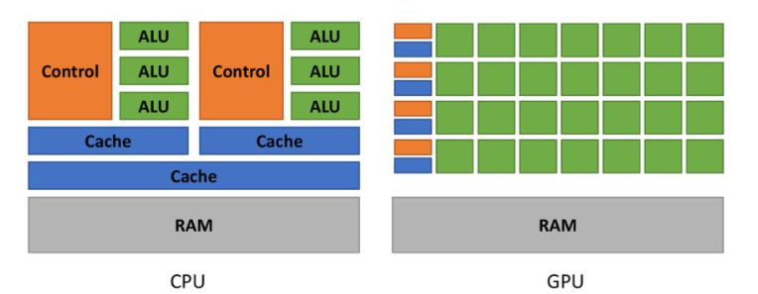
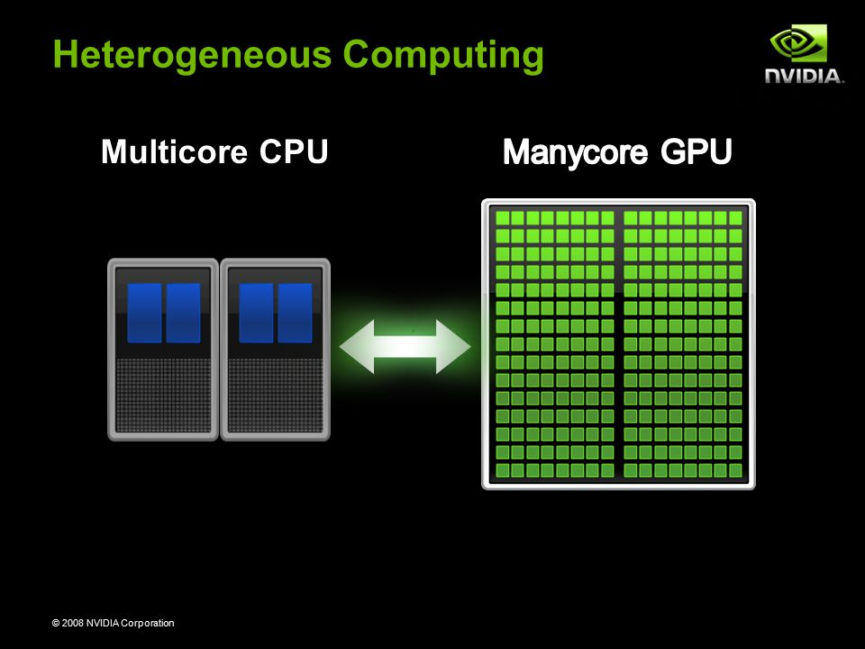
GPUs: Specialized Manycore Processors
Contain thousands of lightweight cores
Designed for data-parallel tasks
SIMT: Single Instruction, Multiple Threads
Common APIs:
CUDA (NVIDIA)
ROCm (AMD)
Used in ML, 3D rendering, physics, finance

Slide 10
Comparison Table
Feature | Dynamic Scheduling | SMT | CMP | GPU
Parallelism Type | Instruction-level | Thread-level | Core-level | Data-level (SIMT)
Best For | Single-thread perf | Latency hiding | Multitasking, servers | Vector-heavy workloads
Hardware Complexity | High | Medium | Medium | High
Software Requirements | Low | Medium | High | Very High (CUDA/OpenCL)

Slide 11
Conclusion
Dynamic Scheduling: Great for boosting single-thread speed
SMT: Improves throughput by hiding stalls
CMPs: Enables multitasking and parallel workloads
GPUs: Dominant for highly parallel, data-intensive apps
Future Trend: Heterogeneous Computing (CPU + GPU + AI/TPU)

Slide 12
Q&A
Thank You

